Slide 1
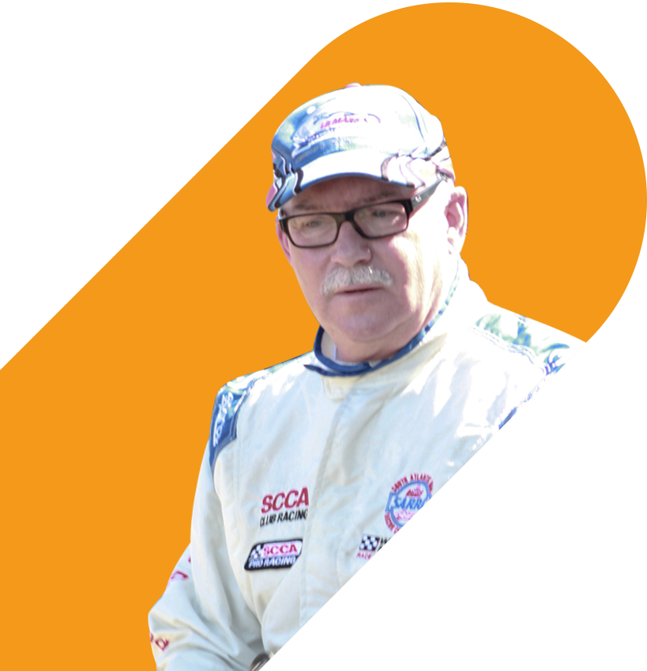
Mike
Marks
Indian River
Consulting Group
Enhancing the Customer Experience (CX)
Digital Transformation for Today’s Distributors
Fall Seminar Series

Slide 2
What exactly is CX?
Customer experience (CX) refers to how a business engages with its customers at every point of their buying journey—from marketing to sales to customer service and everywhere in between, including the personal relationships and trust. In large part, it's the sum total of all interactions a customer has with your brand.
Selling service with excellent people is a data free analog version where whack-a-mole reactions to mistakes are the norm.
It can’t be enhanced if it is not mapped and measured, do you remember Tom Peter’s story about restaurant service in his Good to Great book?

Slide 3
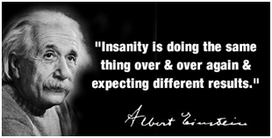
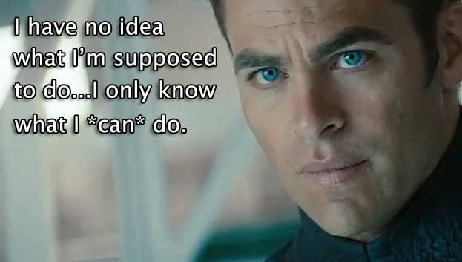
First, A Word About Supply Chain Stupidity
Why is everyone doing what they did before, only harder, louder, and meaner?
You are living in a world changing event, so do something different to support your customers
It is about the customer, not you
Add more staff to daily pre expedite
Show customers how to order with more lead time, it’s a great story that they can use with their other suppliers
Provide substitutions, including selling products from competitors
Allocate product to good, not big, customers

Slide 4
Enhancing the Customer Experience (CX)
It starts with customers and doesn’t involve the sales force as they are trained to listen and respond, not listen to understand*
Adaptive Interviews
Start by interviewing customers with non-sales staff: Ops, HR, Finance
Focus on self-reporting and make sure it is about them, not you
The team documents their notes
Map the Key Touch Points
Start with key processes that have the most friction
Add details from the customer facing team
Validate in a focus group with customers
Recognize that This Is an Ongoing Process, Not a Project
Build a data-driven feedback loop and always have a couple of projects to improve your weakest areas
Make enhancement changes, rinse & repeat
* Any CRM implementation should start with these steps

Slide 5
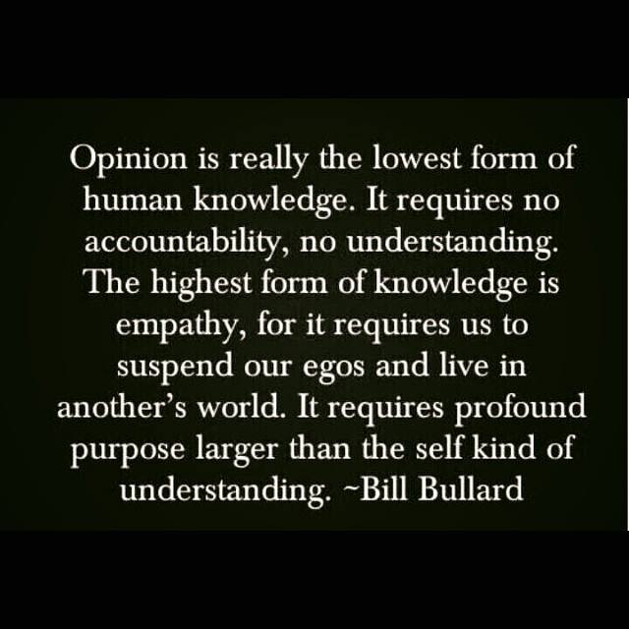
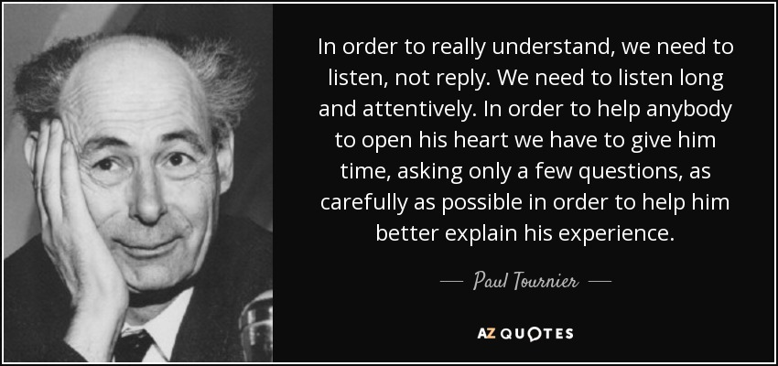
Success Requires Getting Out Of Your Echo Chamber
Go Google the Term ‘Qualitative Research Interview Methods’
This is all about them, and not about you, for now
When we have a rich picture of their pain, frustration, and unmet desires, it then becomes what we can do to help them

Slide 6
Example Customer Interview Questions; Keep Your List Short
Self Reporting Is Key – Always Try to Separate the Message from the Messenger
We are trying to improve your customer experience, so it would help us a lot if you could describe the challenges and frustrations that exist in your role today?
How would you organize them as daily issues or ones that are episodic or annual?
Without naming names, how do your best suppliers help you deal with these challenges?
What would help you the most in services or support that you can’t find in any of your suppliers today?
When an issue comes up what kind of response times to resolve it are critical versus nice to have?
We are investing heavily in digital to support our customers, so it would help to know what initiatives you have underway or are considering for your future?
If you had $100,000 to invest to improve your sourcing effectiveness, where would you spend it?
If you were going to send a message to my executive management, what would it be?
If our firm went away, what would you miss the most?
The only question about you!

Slide 7
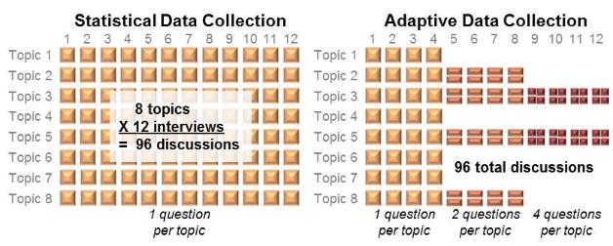
The Interview Guide Will Change at Least 3 or 4 Times
Behavioral Segmentation Groups Customers By What They Seek and Value
Change the interview guide by deleting questions where you already know the answer and add questions that evolve from new insight
  Typically, an interview guide goes through multiple versions
The net result of this activity is an understanding of each customer segment by how they choose to interact with us, i.e., what our value proposition is to them
Reality Test: I can give you a customer segment and you can tell me what wakes them up at night and what they really care about
When you know the answer stop asking the question and replace it with a new one

Slide 8
How to Map Your Touchpoints with Your Customers
All the Touch Points Belong in Several Processes as Defined Steps
As you accumulate data, group them into processes and these lists will get you started
Order to cash process examples
  Order fulfillment process – standard products
  Order fulfillment process – custom products
  Outbound delivery verification process
  Project changeout documentation process
  Invoicing & collection process
Demand forecast process
Inquiry to quote submittal process
Customer stock rotation process
How to get a quick answer without going to the website
Issue identification to resolution process
Build a list of friction points from customer interview insights
Create early warning processes and quick reactions via digital solutions
Focus on the big ones first
Nearly two-thirds of respondents* ranked the ability to act on CX issues in near real time [first call or text] as among their top three priorities
If you can’t measure it, then you can’t enhance or improve it
* https://www.mckinsey.com/business-functions/marketing-and-sales/our-insights/prediction-the-future-of-cx

Slide 9
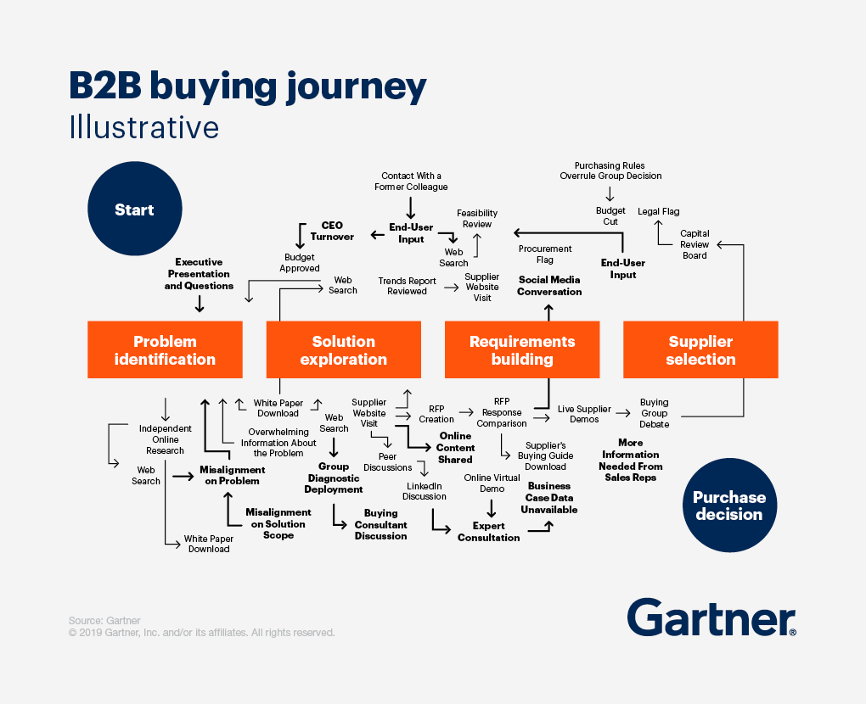
Now Map the Steps for Each Process
Go to Google Images at https://www.google.com/imghp
and type in ‘B2B Customer Journey Maps’
Go through the examples to find ideas to design your own flow chart template
Remember that most are focused on the initial sale but ~80% of distributor revenues are flow –meaning repurchases of products
Start with existing customers and you will need different maps for projects versus flow business
Don’t forget feelings and human experience
This has nothing to do with mapping your sales process as that is step two, and most pipeline models turn into dead ends

Slide 10
Enhancing the Customer Experience (CX)
What Do You Do with the Detailed Flowcharts?
Reduce the Steps
Shift from go/no-go approvals to post action controls
Conduct a LEAN analysis to eliminate waste and artifacts from the past
Create tools to simplify the required tasks, e.g., gathering information
Digitize Everything Possible
Start with the customer’s largest friction points
Automate the 20% of events that create 80% of the friction
Speed is a weapon, increase it
Create a Performance Feedback Loop
Create a place to store and integrate data from multiple sources
Use predictive analytics (ML/AI) to anticipate earlier
Conduct data reviews in scheduled meetings with defined actions

Slide 11
Useful How-To Research Links
Review These Links to Help Create the Perfect Interview Guide for Your Firm
https://blogs.oracle.com/cx/post/15-definitions-of-customer-experience
https://www.mckinsey.com/business-functions/marketing-and-sales/our-insights/prediction-the-future-of-cx?cid=other-eml-alt-mip-mck&hdpid=6d5a1310-1c8d-4ce9-880c-d651dfb5434e&hctky=1884470&hlkid=f10b404d830e4a02b717f65feb017ced
https://www.mckinsey.com/business-functions/marketing-and-sales/our-insights/improving-the-business-to-business-customer-experience
https://www.lucidchart.com/blog/how-to-build-customer-journey-maps
https://www.userinterviews.com/blog/best-customer-journey-map-templates-examples
https://customerthink.com/10-b2b-customer-experience-myths-how-to-improve-your-cx-maturity/
https://www.forbes.com/sites/blakemorgan/2019/11/11/20-fresh-examples-of-customer-experience-innovation-for-b2b/?sh=2d3934a06054
https://www.sana-commerce.com/blog/b2b-customer-experience-pillars/
https://www.hubledigital.com/blog/removing-friction-from-the-customer-experience
https://hbr.org/2016/09/know-your-customers-jobs-to-be-done
https://www.youtube.com/watch?v=Stc0beAxavY
https://www.forbes.com/sites/shephyken/2019/06/09/are-you-providing-a-frictionless-customer-experience/?sh=3b5025a14b8c
https://www.ericschwartzman.com/how-to-improve-customer-experience/
https://beyondphilosophy.com/friction-in-cx-how-to-avoid-getting-burned-by-hidden-costs/

Slide 12
Thank You

