Slide 1

Mike
Marks
Indian River
Consulting Group
Investment Roadmap for Digital Transformation
Digital Transformation for Today’s Distributors
Fall Seminar Series

Slide 2
ROI Defined from Investopedia
.
Return on investment (ROI) is a performance measure used to evaluate the efficiency or profitability of an investment or compare the efficiency of a number of different investments. ROI tries to directly measure the amount of return on a particular investment, relative to the investment’s cost.
To calculate ROI, the benefit (or return) of an investment is divided by the cost of the investment. The result is expressed as a percentage or a ratio
but
The return on innovation investment is calculated by comparing the profits of new product or service sales to the research, development, and other direct expenditures generated in creating these new products or services.

Slide 3
What Goes into the Calculation
The Issue with Innovation Investment Is the Uncertainty and Number of Variables
Investment phases requiring executive time and capital to be included
  Executive research to link external forces of change to their specific market using technology tools to create their North Star
  There are the capital investment and non-recurring start up costs to bring the new model online at Minimum Viable Product (MVP) performance
  There is the organizational change management process so the revised structure can embrace and utilize the new model that is defined in a specific project plan (usually in parallel with item #2)
  There are the recurring costs to operate the model and keep up with technology upgrades (you will learn about technology stack vulnerability)
Innovation investment returns, over current state, to be included
  Lower SG&A costs going forward, higher market making (growth) productivity, lower customer attrition, higher capital turns, and potentially higher gross margins

Slide 4
Managing Risk
The probability of success plus the probability of failure always equals one
Without a tipping point to trigger action, the cost of not investing could be a slow death
Mathematical Expectancy (ME) in $ = (Event probability %) X (Consequence $)
Put a few scenarios together and compare ME values
Proven risk reduction strategies
  Higher executive knowledge and understanding of their North Star and Go-To-Market (GTM) pivot project plan, leading from the front
  Investing with enough scale to warrant the necessary executive attention, i.e., skin in the game
  Choosing best of breed versus a single software provider, but know every full-service solution firm violently disagrees; Incremental short term returns help fund the next investment
  Choosing to be a fast follower with strong sensing mechanisms to know where the leaders are in the industry transition
  Regular review of direct customer insight that does not come from the sales force

Slide 5
Create Your North Star
This Defines the End Game So You Can Iteratively Define the Costs and Benefits
You want your customers, when they look around in two to four years, to see your firm as the one that has their act together and knows how to win in this new game, yes you are expensive - but you are really good
North Star
Have a discussion about your customers sorting them into winners, losers, and those that are uncertain (list the selection criteria as they are created)*
Consider your change scenarios (developed with executive research) and think about where your winners will be in several years based on how they react to these changes, and how they will compete and source differently, considering increasing purchase concentration
Then define the new capabilities they will need to succeed so you can provide a value proposition that makes you their obvious and only choice
Then build plans to realign your resources to the emerging growth opportunities
* You will likely find that current revenue size is a poor predictor

Slide 6
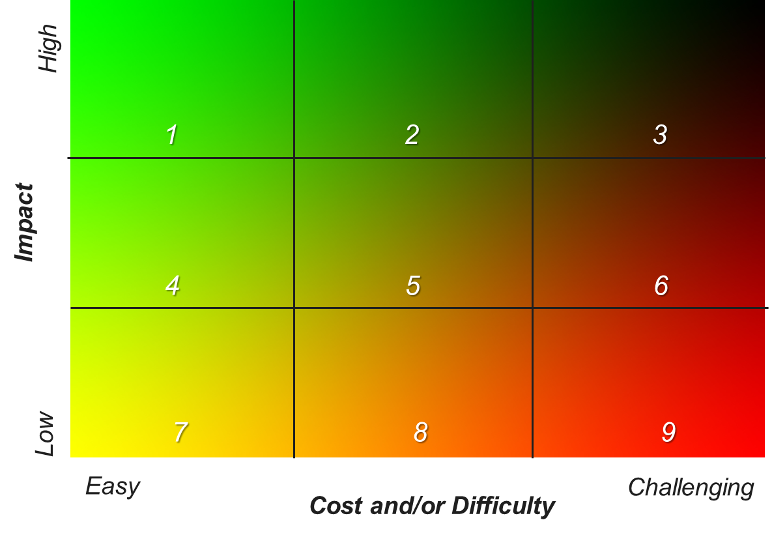
Where to Invest First
Detail Is Important for What Happens First but Fades Quickly Going Out in Time
Define the gaps between today’s present state and the future state of your North Star as this becomes the journey map, a.k.a. strategy
Define the chunks of work that need to be defined and completed that bridge the gap and sort them into themes called core initiatives
Once in core initiatives, redefine or resize the
chunks of work as execution plans that can
be clearly completed in six months or less
Each has their own ROI
Place them in a heat map and start with
those easiest to do with the highest impact
If you are behind your customers or suppliers,
catch up with them first, then go internal

Slide 7
Investment Roadmap for Digital Transformation
So How Do You Start?
Build a high-level innovation investment ROI model with upper and lower limits to track, while you go through the three steps
Executive Research
Execs start spending one hour each day reading and studying
Talk to experts and peers who are ahead of you, not your friends
Go to seminars, read blogs, hire consultants or new executives
Create the North Star
Many meetings involving all the key stakeholders
Start with new customer insight, not from sales reps
Create scenarios and slowly consolidate for the best competitive position
Build and launch the (MVP) Minimum Viable Product
Build out a multi-year investment roadmap
Fund the first year aggressively (skin in the game)
Monitor carefully and learn for next year

Slide 8
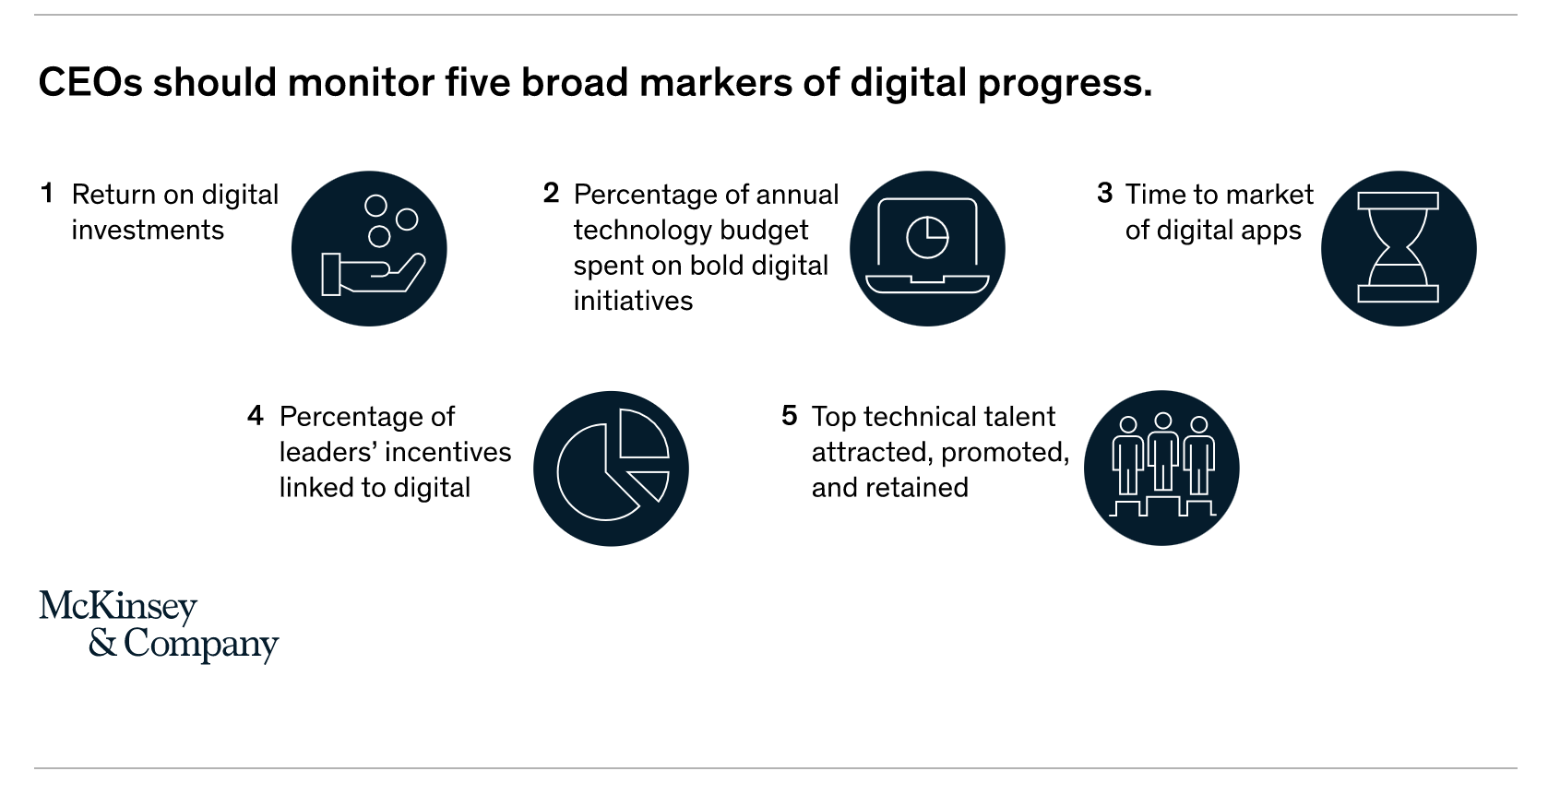
Track Your Progress Carefully with Discipline
Have Formal Quarterly Reviews, and Include This in the Monthly Meeting Agendas
These are great Key Performance Indicators for a strategic journey
https://www.mckinsey.com/business-functions/mckinsey-digital/our-insights/how-do-you-measure-success-in-digital-five-metrics-for-ceos?cid=other-eml-alt-mip-mck&hdpid=964cfc4f-adbf-4719-8d29-609ba4c06499&hctky=1884470&hlkid=0a70a458bc084699b9b529a7ef5c6b4c

